Slide 1

CD_Player
Prepared By:Sara Mohamme.
By the supervisor:Dr\khaled.

Slide 2
Introduction
The project is about how running an Audio CD by tracks not by files.

Slide 3
The functionality of the project:
  It opens the cdrom and play the cd.
It shows the number of tracks on the cd.
It shows the time for each track.
It can move from one track to another.

Slide 4
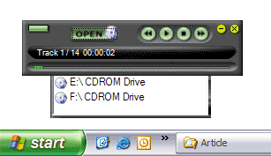
The Design

Slide 5
The classes
CD_PLAYER
this class is the program class
CONTROL_DEVICES
this class is pre-defined class for control
all devices

Slide 6
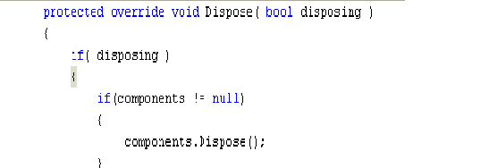
The functions for cd_player class
Dispose Function
Void Dispose function (bool disposing):
-this function arrange the existing devices.
The declaration

Slide 7
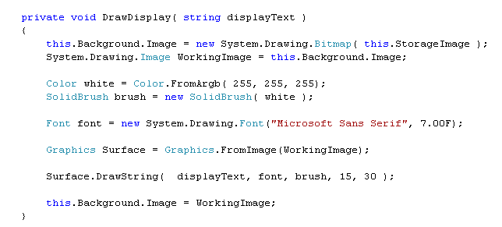
Con function
Draw-Display Function
Void DrawDisplay( string displayText ):
-this function is used to define the font and the color to write astring on the Background of the form and
graphics of the window form
The declaration

Slide 8
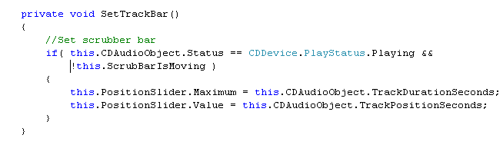
Con function
SetTrackBar
Function
void SetTrackBar():
-this function displaTrackDurationSeconds
or TrackPositionSeconds
The Declaration

Slide 9
The functions
For
DEVICE_CONTROLER Class
Play().
Pause().
Stop().
Next().
Previous().
-those functions are used to control tracks

Slide 10
The Buttons

Slide 11
Eject Button
This button is used to open the selected Device and close it.
After choose the device and put the CD in it. The CD plays automatic.
this.CDAudioObject.Eject();
Eject-Button Code

Slide 12

Drive Button
This Button is used to open a list of all existing CD-audio devices and choose one of them.
The code for drive-Button

Slide 13

Previous Button
This button is used to transfer to the previous track.

Slide 14

Next Button
This Button is used to transfer to the next Track

Slide 15
Play Button
This Button is used to play-on OR play-off the sound.

Slide 16
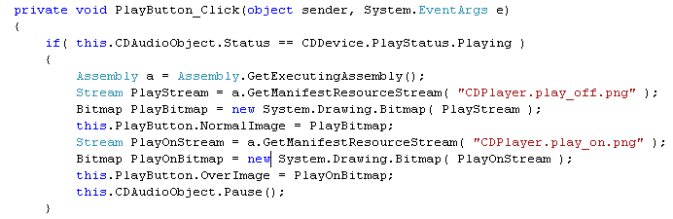
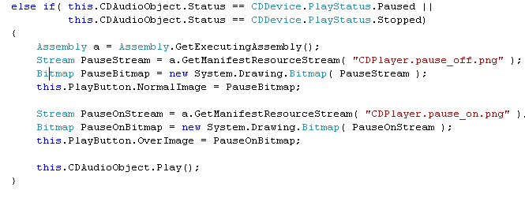
Play-Code
GetEntryAssembly does in fact give the right.exe assembly. It looks like any application failed to pick up thechange in the DLL when I rebuilt it
Loads the specified manifest resource from this assembly

Slide 17
Stop Button
This Button is used Stop the playing track.

Slide 18
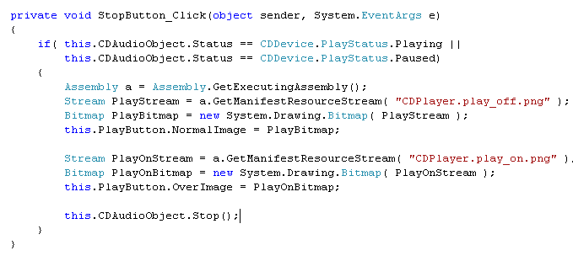
Stop-Code

Slide 19

Closing-Button
This Button is used to Close the form and consequently cancel the sound.

Slide 20

Minimize-Button
This Button is used to minimize the form.

Slide 21
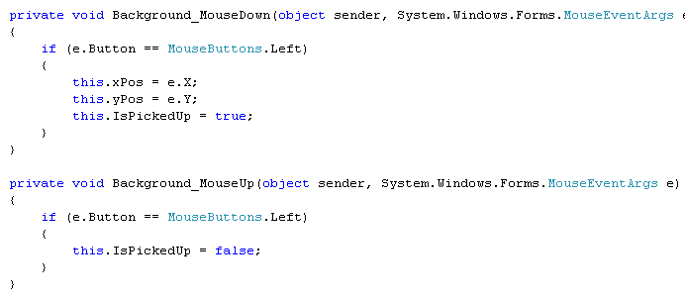
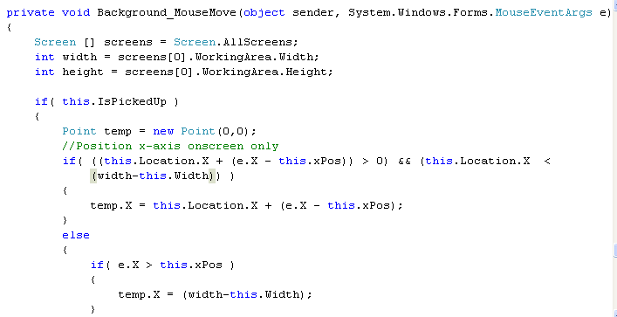
Some Events on the Back ground
Whenpress the left Button on the mouse
When no press the left Button on the mouse
Whenpress the left Button on the mouse and drag the form

Slide 22
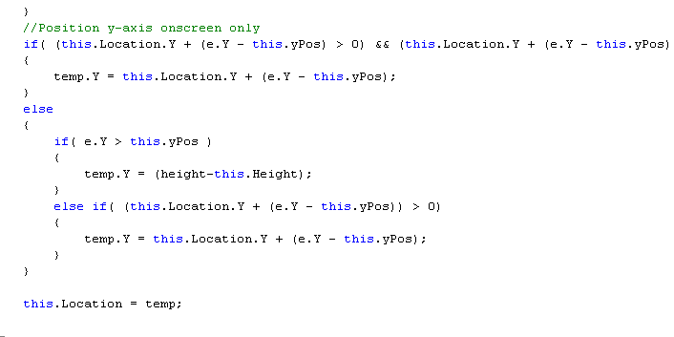

Slide 23
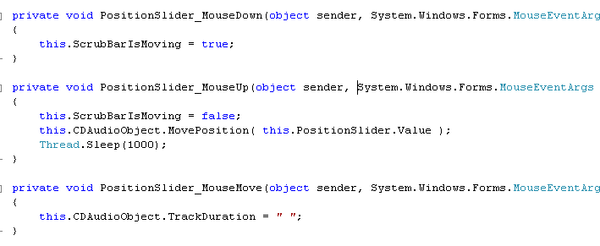
Some Events on the Slider
Whenpress the left Button on the mouse
When no press the left Button on the mouse
Whenpress the left Button on the mouse and drag the form

Slide 24
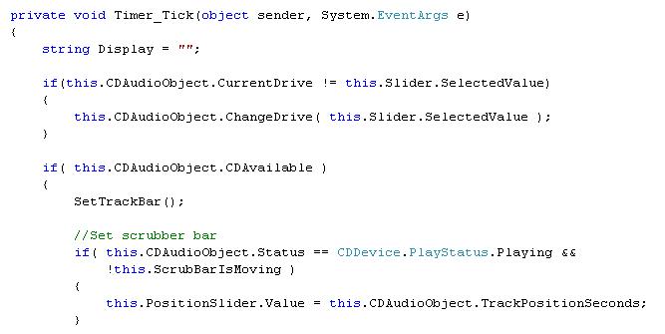
The timer

Slide 25
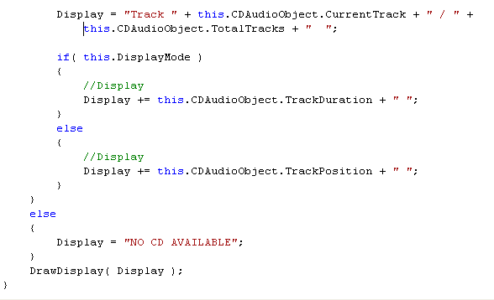
Cont-timer tick

Slide 26
The Device Controller class

Slide 27
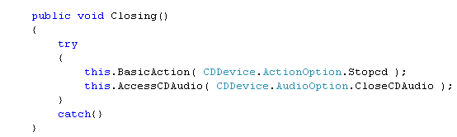
Closing function
This function stoped the cd then close it.

Slide 28
Eject-Function
We call this function when Press the eject button.
It used to open or close the cd-device and show the tracks.
it used some variables such Door Option which will be 0 when the door is closed and 1 otherwise.

Slide 29
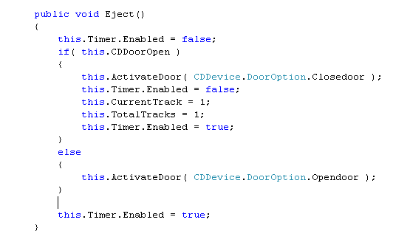
Eject-Code
Here test if the cd-door is opened
It closed it and put the initial values to these variables then set the timer ti be enable.
Else if the cd-door is closed it open it to insert the cd.

Slide 30
Play function
This function is used to transfer to the playing state from any other state such Paused or stop states.
It uses two functions:
-FixSting (string) it take the string as stream of characters and test if it was safe or unsafe character.
-cdMediaStatus() : it returns Boolean as it convert the string result from the FixString function to true or false.

Slide 31
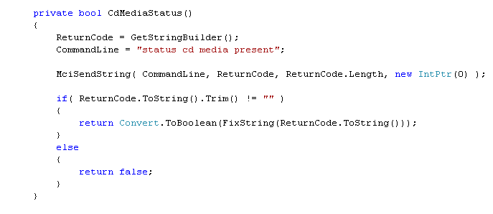
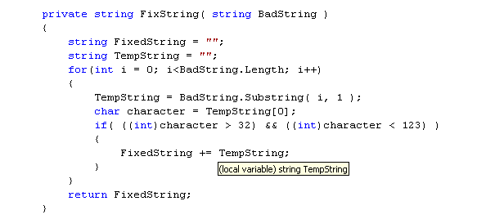
it take the string as stream of characters and test if it was safe or unsafe character.
it returns Boolean as it convert the string result from the FixString function to true or false.

Slide 32
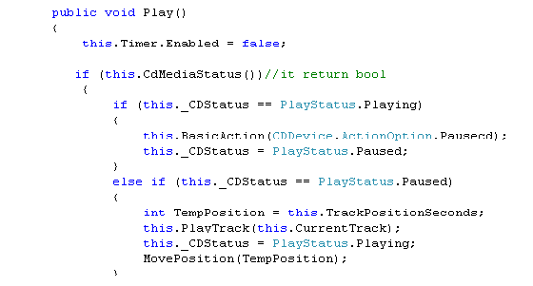
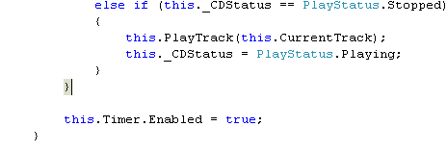
Play-code
Play Status is enum:
public enum PlayStatus
{Playing = 0,
Stopped = 1,
Paused = 2}

Slide 33
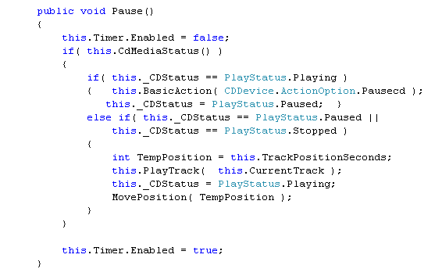
Pause Function
This function is used to pause the sound from the playing state, or to play the sound from the paused or stoped state.
Action Option is enum:
public enum ActionOption
{Playcd = 0,
Pausecd = 1,
Stopcd = 2}

Slide 34
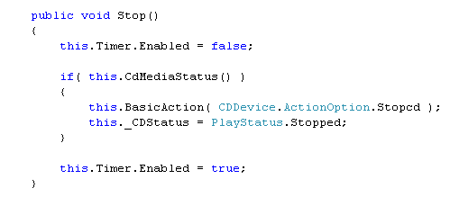
Stop Function
This function is used to stop the sound anyway and from ant state.
Action Option is enum:
public enum ActionOption
{Playcd = 0,
Pausecd = 1,
Stopcd = 2}
Play Status is enum:
public enum PlayStatus
{Playing = 0,
Stopped = 1,
Paused = 2}

Slide 35
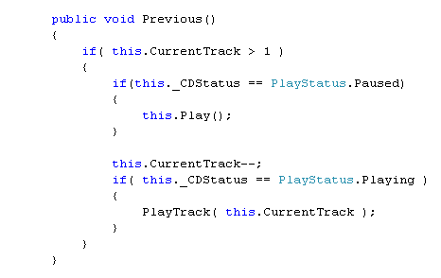
Previous Function
This function is used to play the previous track, it test the current track if it isn't the last one it transfer to previous and if it paused it will be play.
Play Status is enum:
public enum PlayStatus
{Playing = 0,
Stopped = 1,
Paused = 2}

Slide 36
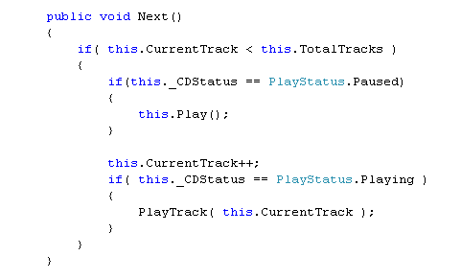
Next Function
This function is used to transfer to the next track.
Play Status is enum:
public enum PlayStatus
{Playing = 0,
Stopped = 1,
Paused = 2}

Slide 37
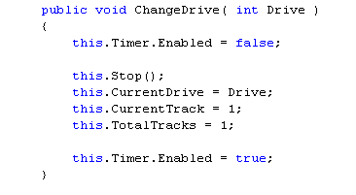
Change drive Function
This function is used to transfer to another Drive.

Slide 38
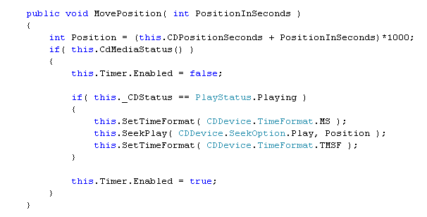
Move Position function
This function is used to set the time format while playing or seeking.
public enum SeekOption
{
Play = 0 Seek = 1
}
Time format is enum:
public enum TimeFormat
{MS = 0, MSF = 1, TMSF = 2}

Slide 39
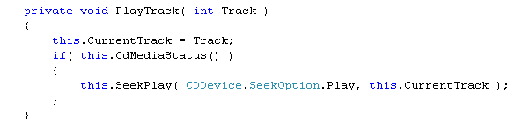
Play Track Function
This function take the number of the track and playing it.

Slide 40
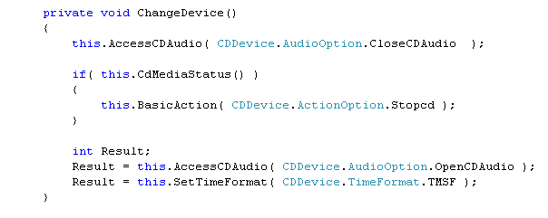
Change Device function
This function take command from Access Audio Function to close the current device and open another and set the time.
Audio option is enum:
public enum AudioOption{ OpenCDAudio 0,
CloseCDAudio = 1}

Slide 41
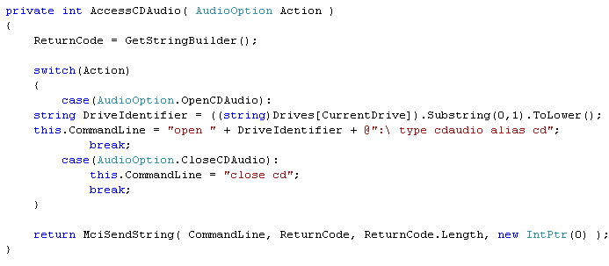
Access Audio Function
This function sends command line to send the taken action to the specified device to close or open it
If the Action is to open the cd,it send to the device to open the cdaudio
If the Action is to closethe cd,it send to the device to closethe cdaudio

Slide 42
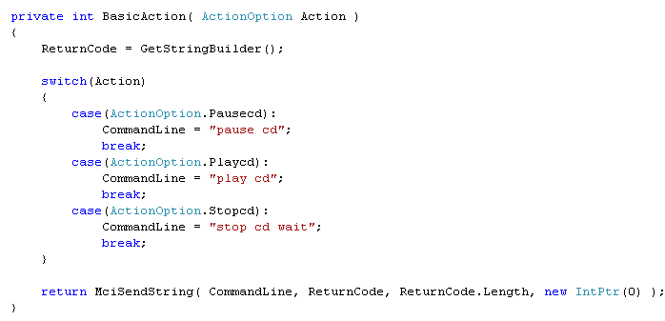
Basic Action Function
This function take the action and send command line to the device.
The Basic actions are Pause,play or stop
Send the command line as string to the device

Slide 43
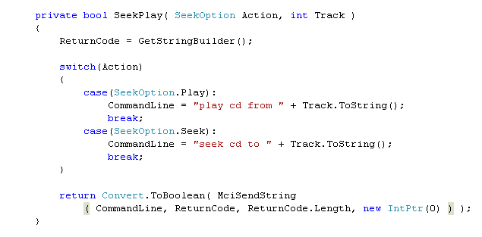
Seek-play function
This function take the action and send command line to the cd-device by playing or seeking.
public enum SeekOption
{
Play = 0 Seek = 1
}

Slide 44
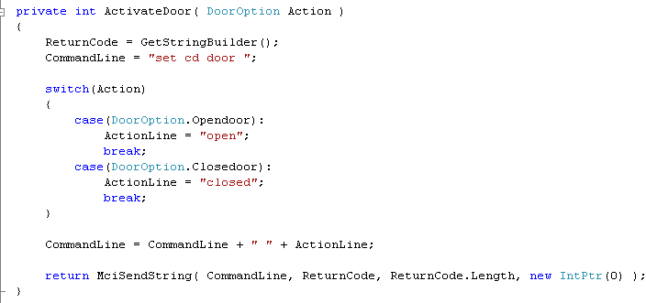
Activate-door function
This function take the action and send command line that cd-device is opened or closed.
Door option is enum as:
public enum DoorOption
{
Closedoor = 0,
Opendoor = 1
}

Slide 45

getStringBuilder function
This function Represents a mutable string of characters
The value is said to be mutable because it can be modified once it has been created by appending, removing, replacing, or inserting characters.
StringBuilder is automatically created.

Slide 46
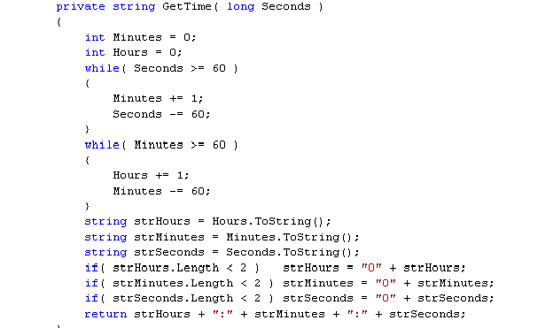
GetTime function
Calculate the time and set it into specific format

Slide 47
The references
http://www.codeprojects.com/cs/media/cdplayer.asp

Slide 48
The End

